Slide 1
Chapter 9: Virtual Memory

Slide 2
Background
Virtual memory – separation of user logical memory from physical memory.
  Only part of the program needs to be in memory for execution
  Logical address space can therefore be much larger than physical address space
  Allows address spaces to be shared by several processes
  Allows for more efficient process creation
Virtual memory can be implemented via:
  Demand paging
  Demand segmentation

Slide 3
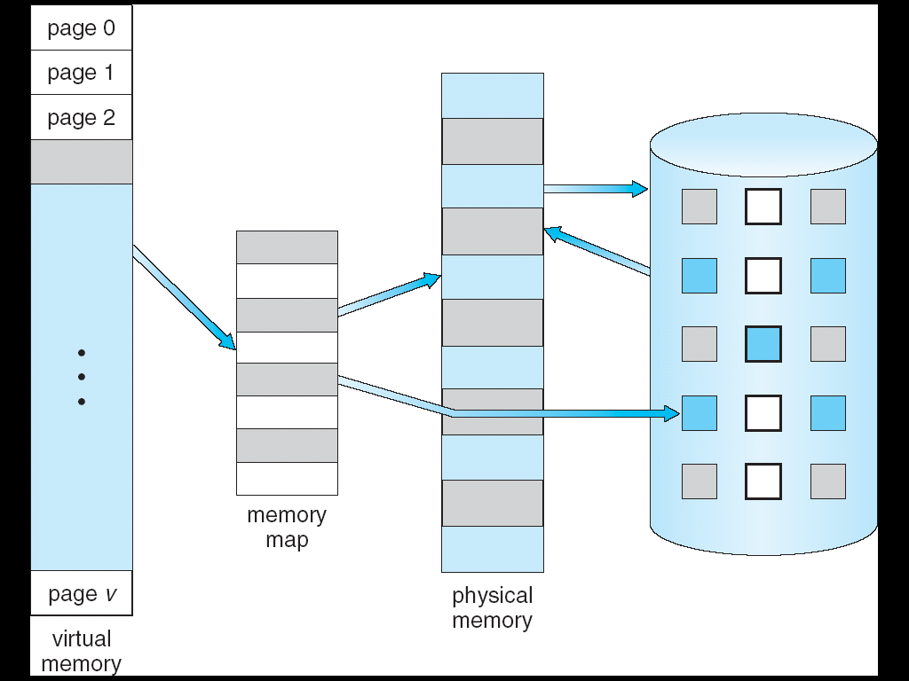
Virtual Memory That is Larger Than Physical Memory
⇒

Slide 4

Virtual-address Space

Slide 5

Shared Library Using Virtual Memory

Slide 6
Demand Paging
Bring a page into memory only when it is needed
  Less I/O needed
  Less memory needed
  Faster response
  More users
Page is needed ⇒ reference to it
  invalid reference ⇒ abort
  not-in-memory ⇒ bring to memory
Lazy swapper – never swaps a page into memory unless page will be needed
  Swapper that deals with pages is a pager

Slide 7
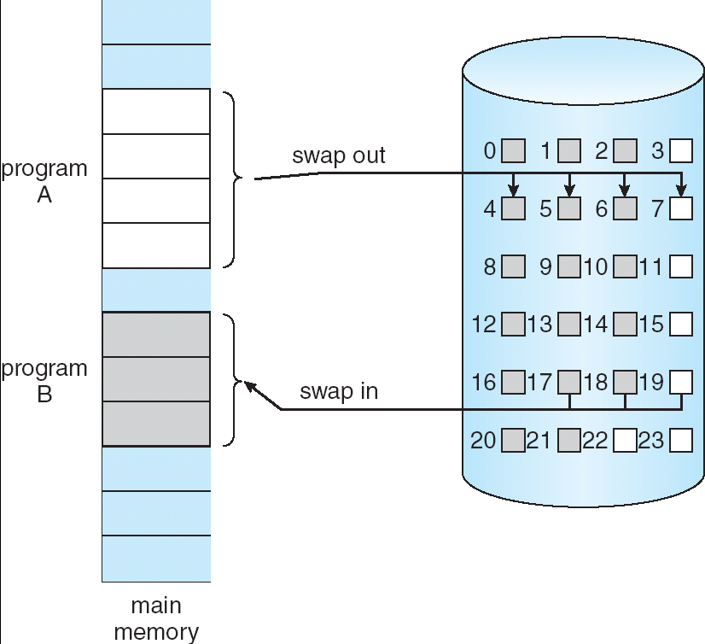
Transfer of a Paged Memory to Contiguous Disk Space

Slide 8
Valid-Invalid Bit
With each page table entry a valid–invalid bit is associated
(v ⇒ in-memory, i ⇒ not-in-memory)
Initially valid–invalid bit is set to i on all entries
Example of a page table snapshot:
During address translation, if valid–invalid bit in page table entry
is I ⇒ page fault
Frame #
valid-invalid bit
v
v
v
v
i
….
i
i
page table

Slide 9

Page Table When Some Pages Are Not in Main Memory

Slide 10
Page Fault
If there is a reference to a page, first reference to that page will trap to operating system:
page fault
Operating system looks at another table to decide:
  Invalid reference ⇒ abort
  Just not in memory
Get empty frame
Swap page into frame
Reset tables
Set validation bit = v
Restart the instruction that caused the page fault

Slide 11
Page Fault (Cont.)
Restart instruction
  block move
  auto increment/decrement location

Slide 12

Steps in Handling a Page Fault

Slide 13
Performance of Demand Paging
Page Fault Rate 0 ≤ p ≤ 1.0
  if p = 0 no page faults
  if p = 1, every reference is a fault
Effective Access Time (EAT)
EAT = (1 – p) x memory access
+ p (page fault overhead
+ swap page out
+ swap page in
+ restart overhead
)

Slide 14
Demand Paging Example
Memory access time = 200 nanoseconds
Average page-fault service time = 8 milliseconds
EAT = (1 – p) x 200 + p (8 milliseconds)
= (1 – p x 200 + p x 8,000,000
= 200 + p x 7,999,800
If one access out of 1,000 causes a page fault, then
EAT = 8.2 microseconds.
This is a slowdown by a factor of 40!!

Slide 15
What happens if there is no free frame?
Page replacement – find some page in memory, but not really in use, swap it out
  algorithm
  performance – want an algorithm which will result in minimum number of page faults
Same page may be brought into memory several times

Slide 16
Page Replacement
Prevent over-allocation of memory by modifying page-fault service routine to include page replacement
Use modify (dirty) bit to reduce overhead of page transfers – only modified pages are written to disk
Page replacement completes separation between logical memory and physical memory – large virtual memory can be provided on a smaller physical memory

Slide 17

Need For Page Replacement

Slide 18
Basic Page Replacement
Find the location of the desired page on disk
Find a free frame:
- If there is a free frame, use it
- If there is no free frame, use a page replacement algorithm to select a victim frame
Bring the desired page into the (newly) free frame; update the page and frame tables
Restart the process

Slide 19

Page Replacement

Slide 20
Page Replacement Algorithms
Want lowest page-fault rate
Evaluate algorithm by running it on a particular string of memory references (reference string) and computing the number of page faults on that string
In all our examples, the reference string is
1, 2, 3, 4, 1, 2, 5, 1, 2, 3, 4, 5

Slide 21

Graph of Page Faults Versus The Number of Frames

Slide 22
First-In-First-Out (FIFO) Algorithm
Reference string: 1, 2, 3, 4, 1, 2, 5, 1, 2, 3, 4, 5
3 frames (3 pages can be in memory at a time per process)
4 frames
Belady’s Anomaly: more frames ⇒ more page faults
1
1
4
5
2
2
1
3
9 page faults
3
3
2
4
1
1
5
4
2
2
1
5
10 page faults
3
3
2
4
4
3

Slide 23

FIFO Page Replacement

Slide 24

FIFO Illustrating Belady’s Anomaly

Slide 25
Optimal Algorithm
Replace page that will not be used for longest period of time
4 frames example
1, 2, 3, 4, 1, 2, 5, 1, 2, 3, 4, 5
How do you know this?
Used for measuring how well your algorithm performs
1
4
2
6 page faults
3
4
5

Slide 26

Optimal Page Replacement

Slide 27
Least Recently Used (LRU) Algorithm
Reference string: 1, 2, 3, 4, 1, 2, 5, 1, 2, 3, 4, 5
Counter implementation
  Every page entry has a counter; every time page is referenced through this entry, copy the clock into the counter
  When a page needs to be changed, look at the counters to determine which are to change
1
1
1
1
5
2
2
2
2
2
3
5
5
4
4
4
4
3
3
3

Slide 28

LRU Page Replacement

Slide 29
LRU Algorithm (Cont.)
Stack implementation – keep a stack of page numbers in a double link form:
  Page referenced:
    move it to the top
    requires 6 pointers to be changed
  No search for replacement

Slide 30

Use Of A Stack to Record The Most Recent Page References

Slide 31
Priority Allocation
Use a proportional allocation scheme using priorities rather than size
If process P_{i} generates a page fault,
  select for replacement one of its frames
  select for replacement a frame from a process with lower priority number

Slide 32
Global vs. Local Allocation
Global replacement – process selects a replacement frame from the set of all frames; one process can take a frame from another
Local replacement – each process selects from only its own set of allocated frames

Slide 33
Thrashing
If a process does not have “enough” pages, the page-fault rate is very high. This leads to:
  low CPU utilization
  operating system thinks that it needs to increase the degree of multiprogramming
  another process added to the system
Thrashing ≡ a process is busy swapping pages in and out

Slide 34

Thrashing (Cont.)

Slide 35
Demand Paging and Thrashing
Why does demand paging work?
Locality model
  Process migrates from one locality to another
  Localities may overlap
Why does thrashing occur?
Σ size of locality > total memory size

Slide 36
Page Size
Page size selection must take into consideration:
  fragmentation
  table size
  I/O overhead
  locality

Slide 37
End of Chapter 9

